Slide 1

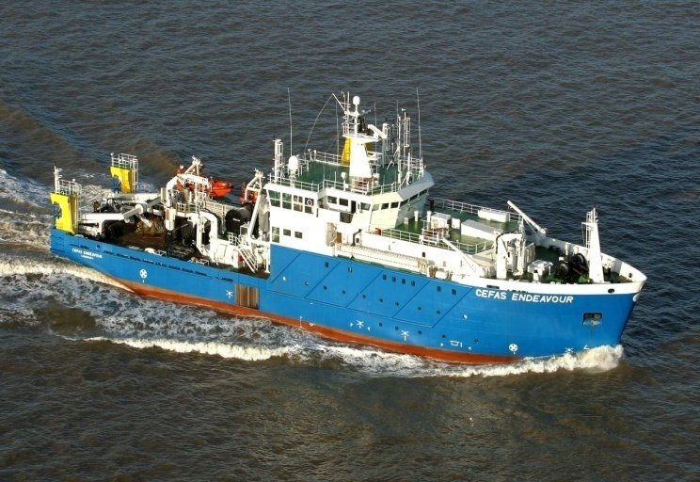
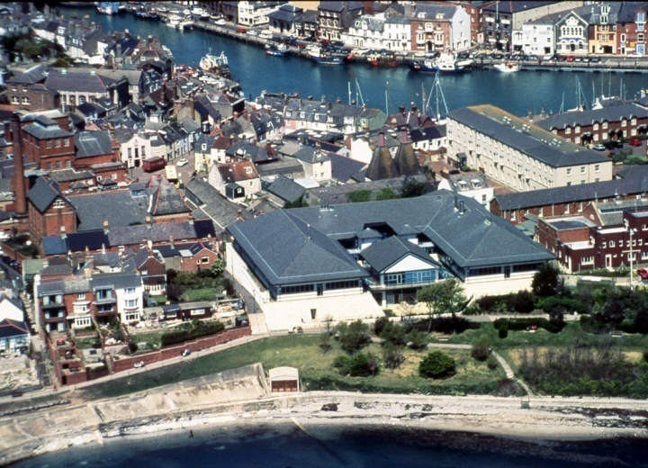
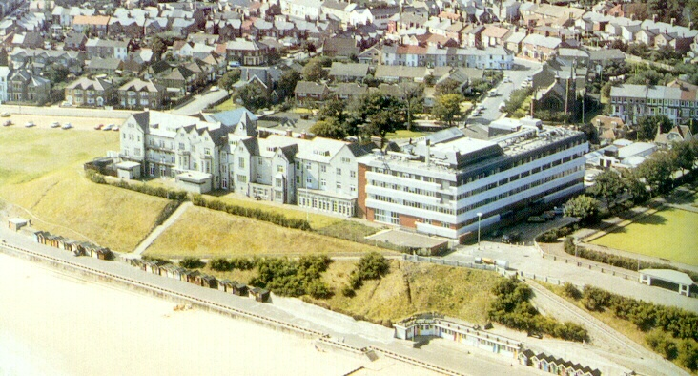
Smarter Marine Monitoring from Space
Rodney Forster, Cefas
RV Endeavour
Weymouth (125)
Lowestoft (375)
1- Current uses in monitoring, operations and forecasting (GMES)
2- Looking forward to Copernicus Marine Core Service and Sentinels
3- Dealing with 10x volume of data

Slide 2
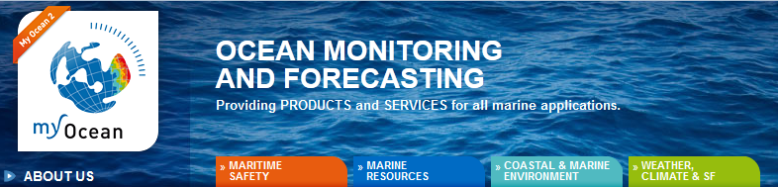
Marine user segment
Ocean colour from space
SeaWIFS / MODIS / MERIS
1997 – 2014
Sediments and optics
Chlorophyll and algal blooms

Slide 3
Applications in the marine sector
 | Standard EO (300-9000 m) | Higher-res EO (1 – 30m)
Eutrophication | DT [chl a; optics]
Marine Energy
offshore wind | DT [SPM; optics] | DT [SPM; optics]
nuclear |  | NRT [SST; chl a]
Fisheries research | NRT [SST; chl a; fronts] DT [chl a; optics]

Slide 4
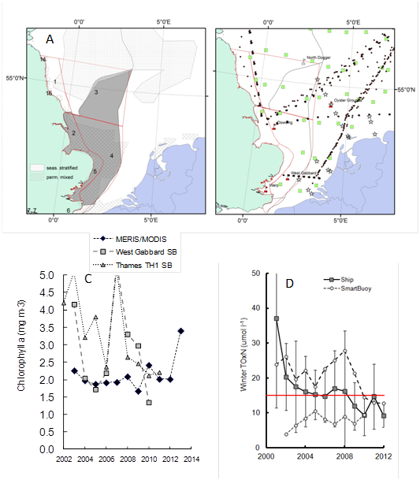
Southern North Sea – water quality

Slide 5
UK water quality assessment - chlorophyll
Validated chlorophyll time series using mix of satellite (MERIS, MODIS, Sentinel) and in situ (buoys, ferrybox, ships, CPR)

Slide 6
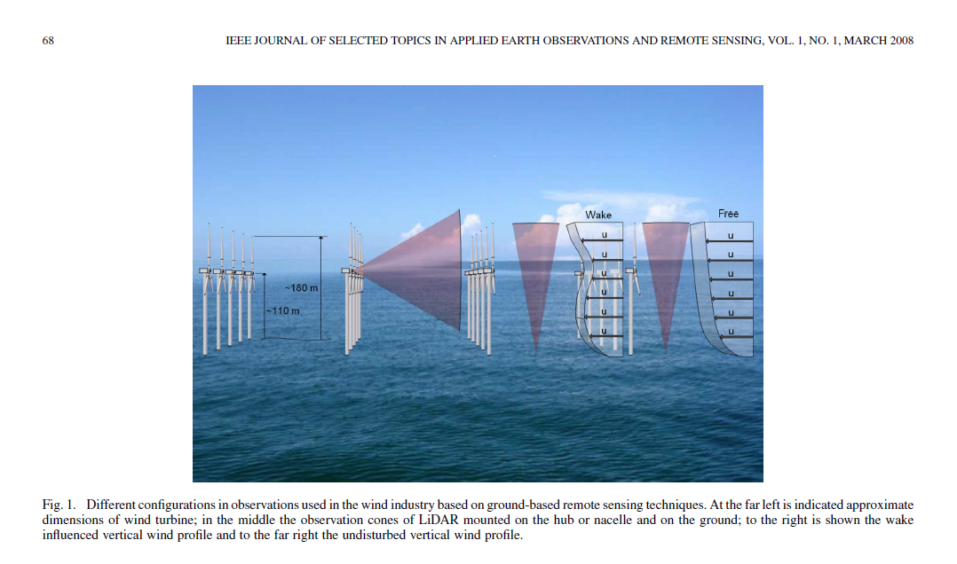
Autonomous marine observations in support of offshore wind
Space, airborne and in situ observations can be of great use to offshore wind industry
Viewing angles of LiDAR for within farm wind fields
Regional scale wind mapping from satellite SAR; wake effects with airborne SAR
Norsewind project (Hasager et al.)
Research at Cefas – looking at the local effects of windfarms on cloud and fog formations using ocean colour satellite obs.
Notes:
Offshore wind already uses remote and autonomous observations primarily for quantifying wind resources. See work of DTI.

Slide 7
Autonomous marine observations in support of offshore wind
Imaging of windfarm environment using visible satellite imagery
Very High Resolution (1m) QuickBird, RapidEye single monopile
High Resolution (25-60m)
Landsat, DMC, Sentinel II farm scale
Moderate Resolution (300m -1000m)
MERIS, MODIS Sentinel-III regional scale

Slide 8
Autonomous marine observations in support of offshore wind
Flood tide 3rd September 2013
Ebb tide 12th September 2013

Slide 9
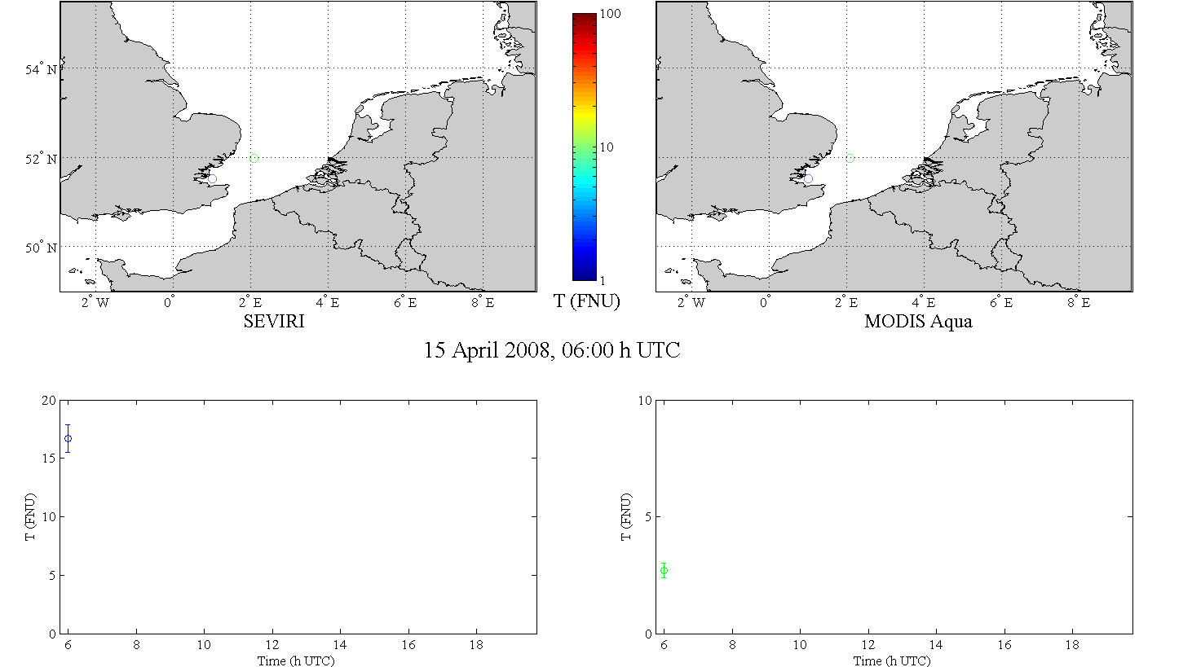
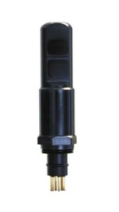
Diurnal variability of Turbidity (RBINS, Cefas)
Imaging from geostationary satellite
Turbidity (FNU)
SEVIRI
In situ
MODIS
[Neukermans et al, 2012; Neukermans, 2012]

Slide 10
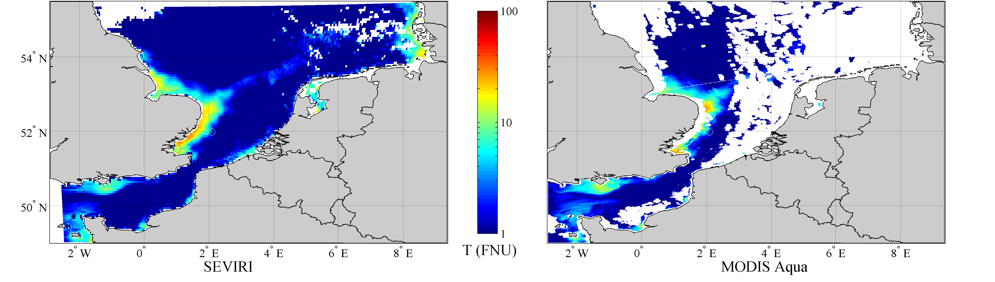
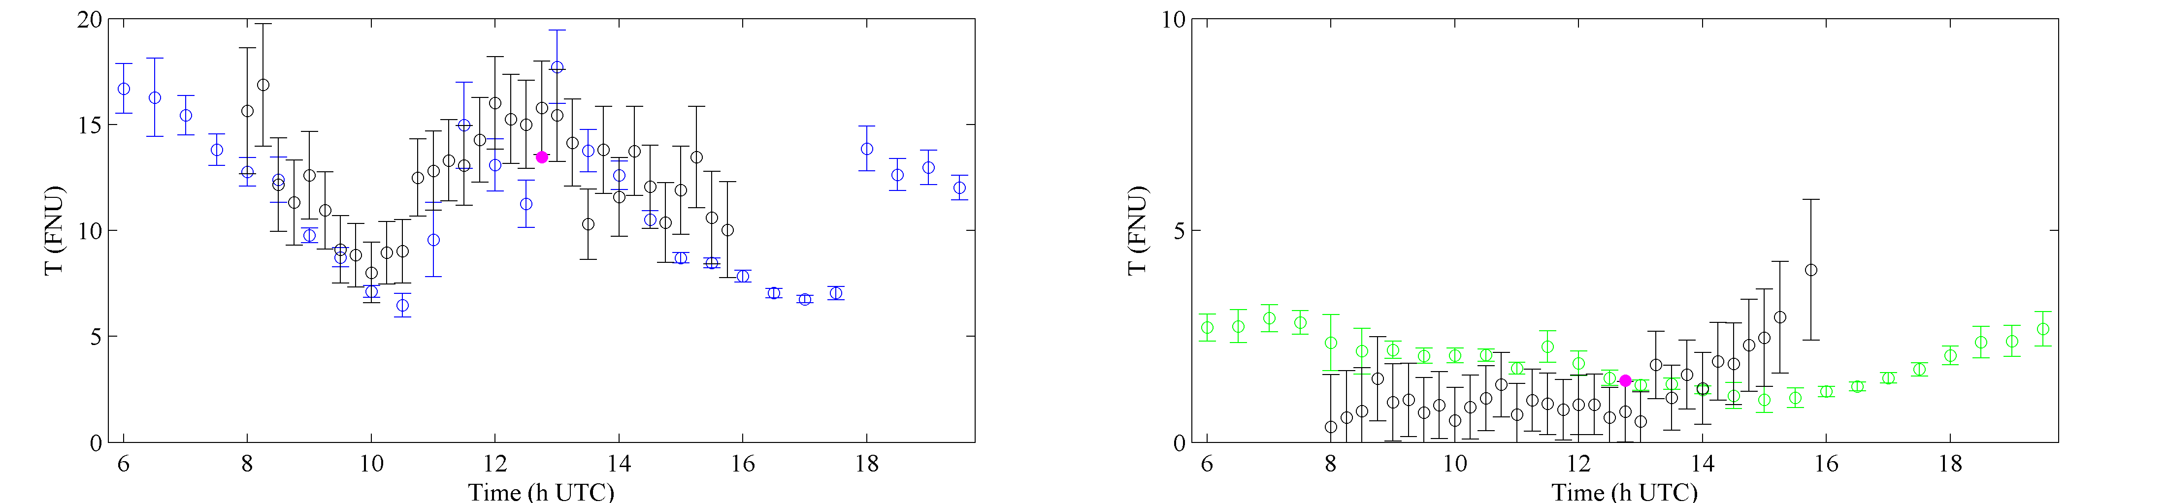
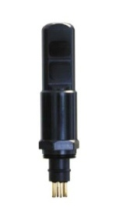
Imaging from geostationary satellite
Quasi cloudfree
60% clouded
Turbidity (FNU)
remotely sensed ( ) vs. in-situ ( , ) diurnal variability of turbidity
t(T_{max})
t( )
SEVIRI
In situ
MODIS
[Neukermans et al, 2012; Neukermans, 2012]

Slide 11
FP7 Space call HIGHROC (2014-2018)
“High spatial and temporal resolution ocean colour products and services”
EU/FP7 funded: 2014-2017
Consortium: RBINS/MUMM, UPMC/LOV, NIVA, BC, VITO, CEFAS
High temporal
resolution
MSG/SEVIRI
Medium resolution
Ocean Colour
MERIS, MODIS … Sentinel-3/OCLI
High spatial
resolution
Sentinel-2
15mins
300m, 1day
10m
GMES Downstream Services
e.g. MARCOAST
HIGHROC
HIGHROC
End-Users:
EU Water + Marine Strategy Framework Directives
New applications: Windfarms, dredging, etc.
Join HIGHROC User Group for
fasttrack access to the new products

